Slide 1
Emergency Preparedness Merit Badge
Troop 344 and 9344
Pemberville, OH

Slide 2
Emergency Preparedness Requirements
Earn the First Aid Merit Badge.
Do the following:
Discuss with your counselor the aspects of emergency preparedness:
Prevention
Protection
Mitigation
Response
Recovery
Include in your discussion the kinds of questions that are important to ask yourself as you consider each of these.

Slide 3
Emergency Preparedness Requirements
Do the following:
Using a chart, graph, spreadsheet, or another method approved by your counselor, demonstrate your understanding of each aspect of emergency preparedness listed in requirement 2a (prevention, protection, mitigation, response, and recovery) for 10 emergency situations from the list below. You must use the first five situations listed below in boldface, plus any other five of your choice. Discuss your findings with your counselor.
Home kitchen fire
Home basement/storage room/garage fire
Explosion in the home
Automobile accident
Food-borne disease (food poisoning)
Fire or explosion in a public place
Vehicle stalled in the desert
Vehicle trapped in a blizzard
Earthquake or tsunami

Slide 4
Emergency Preparedness Requirements
Do the following:
Using a chart, graph, spreadsheet, or another method approved by your counselor, demonstrate your understanding of each aspect of emergency preparedness listed in requirement 2a (prevention, protection, mitigation, response, and recovery) for 10 emergency situations from the list below. You must use the first five situations listed below in boldface, plus any other five of your choice. Discuss your findings with your counselor.
Mountain/backcountry accident
Boating accident
Gas leak in a home or a building
Tornado or hurricane
Major flooding or a flash flood
Toxic chemical spills and releases
Nuclear power plant emergency
Avalanche (snowslide or rockslide)
Violence in a public place

Slide 5
Emergency Preparedness Requirements
Do the following:
Meet with and teach your family how to get or build a kit, make a plan, and be informed for the situations on the chart you created for requirement 2b. Complete a family plan. Then meet with your counselor and report on your family meeting, discuss their responses, and share your family plan.
Show how you could safely save a person from the following:
Touching a live household electric wire.
A structure filled with carbon monoxide
Clothes on fire.
Drowning using nonswimming rescues (including accidents on ice).
Show three ways of attracting and communicating with rescue planes/aircraft.

Slide 6
Emergency Preparedness Requirements
With another person, show a good way to transport an injured person out of a remote and/or rugged area, conserving the energy of rescuers while ensuring the well-being and protection of the injured person.
Do the following:
Take part in an emergency service project, either a real one or a practice drill, with a Scouting unit or a community agency.
Prepare a written plan for mobilizing your troop when needed to do emergency service. If there is already a plan, explain it. Tell your part in making it work.

Slide 7
Requirement 2
Do the following:
Describe the National Incident Management System (NIMS) and the Incident Command System (ICS)
Identify the local government or community agencies that normally handle and prepare for emergency services similar to those of the NIMS or ICS. Explain to your counselor
How the NIMS/ICS can assist a Boy Scout troop when responding in a disaster
How a group of Scouts could volunteer to help in the event of these types of emergencies.
Find out who is your community's emergency management director and learn what this person does to prevent, protect, mitigate, respond to, and recover from emergency situations in your community. Discuss this information with your counselor, utilizing the information you learned from requirement 2b

Slide 8
Emergency Preparedness Requirements
Do the following:
Tell the things a group of Scouts should be prepared to do, the training they need , and the safety precautions they should take for the following emergency services:
Crowd and traffic control
Messenger service and communication.
Collection and distribution services.
Group feeding, shelter, and sanitation.
Prepare a personal emergency service pack for a mobilization call. Prepare a family kit (suitcase or waterproof box) for use by your family in case an emergency evacuation is needed. Explain the needs and uses of the contents.

Slide 9
Emergency Preparedness Requirements
Do ONE of the following:
Using a safety checklist approved by your counselor, inspect your home for potential hazards. Explain the hazards you find and how they can be corrected.
Review or develop a plan of escape for your family in case of fire in your home.
Develop an accident prevention program for five family activities outside the home (such as taking a picnic or seeing a movie) that includes an analysis of possible hazards, a proposed plan to correct those hazards, and the reasons for the corrections you propose.

Slide 10
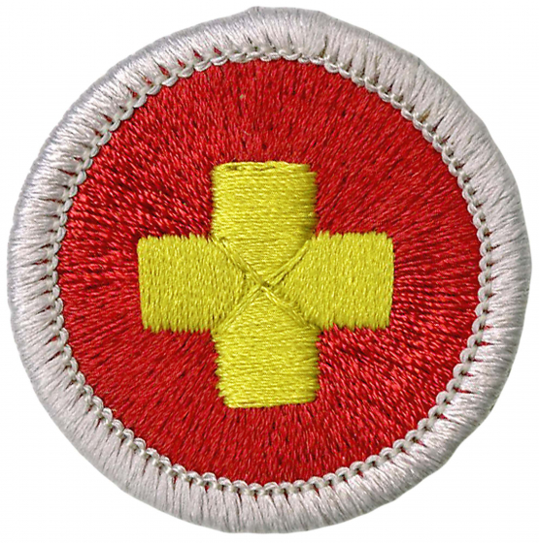
Requirement 1
Earn the First Aid Merit Badge.

Slide 11
Requirement 2
Discuss with your counselor the aspects of emergency preparedness:
Prevention
Protection
Mitigation
Response
Recovery
Include in your discussion the kinds of questions that are important to ask yourself as you consider each of these.

Slide 12
5 Aspects of Emergency Preparedness
The 5 aspects of emergency preparedness are Prevention, Protection, Mitigation, Response, and Recovery.
They were first established by the Federal Emergency Management Agency (FEMA), as a way to improve our national response when facing different types of disasters.
By using the 5 preparedness aspects effectively, you can lessen the damages caused by an emergency, or even prevent it entirely.

Slide 13
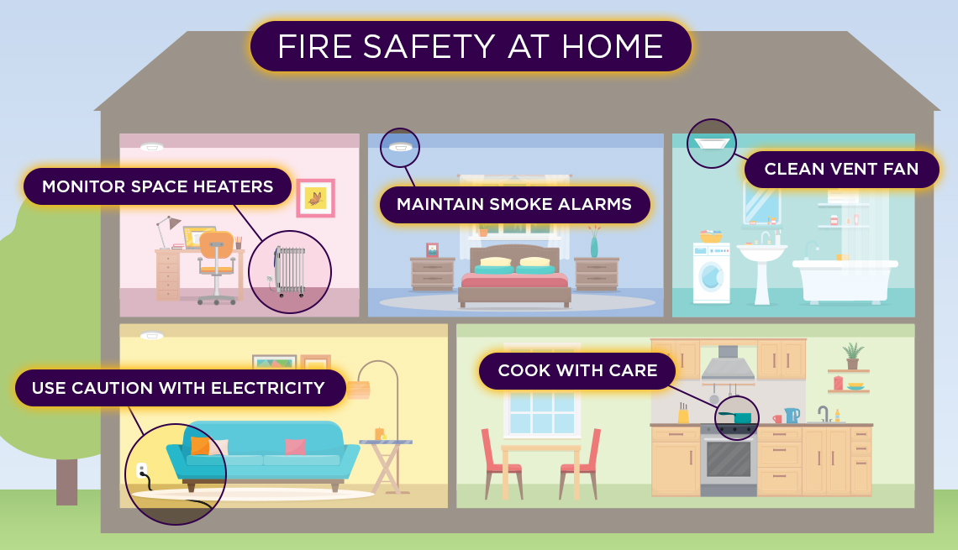
Prevention
Prevention: By planning ahead and taking prevention seriously, you can help prevent accidents from happening.
Questions that will help prevent a dangerous situation or emergency whenever possible:
What can I do to make my home safer?
What can I do to be proactive in preparing my family for emergencies?
What are some of the possible hazards of this activity?

Slide 14
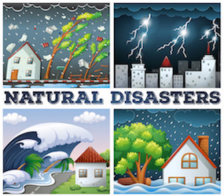
Protection
Protection: When you take actions to prepare for emergencies, you recognize the possible threats from natural and other disasters.
Making a plan and practicing it, assembling an emergency or disaster supplies kit, and installing warning devices are all actions you can take to prepare for an emergency.
Questions that will help protect and prepare for a dangerous situation or emergency whenever possible:
Have I prepared a disaster supplies kit with supplies that will last for at least three days?
Have I made an emergency plan with family members in case of a disaster?
Do I know the safe places to go within my home in case we need to shelter during extreme weather events?
Do I know how to be informed in case of an emergency?

Slide 15
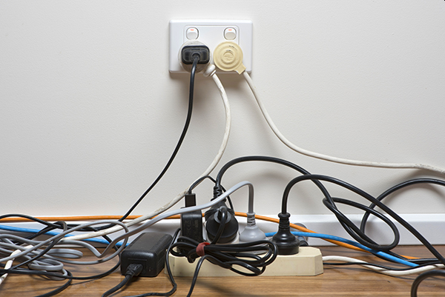
Mitigation
Mitigation: You can help reduce the loss of life and property by lessening the impact of future disasters.
That means taking action before the next disaster.
Questions that will help mitigate the loss of life and property:
How can I help minimize the damage that might be caused during an emergency?
How can I help ensure that no one would be injured during an emergency?
Can I help make sure that people are acting in a safe manner during an emergency?

Slide 16
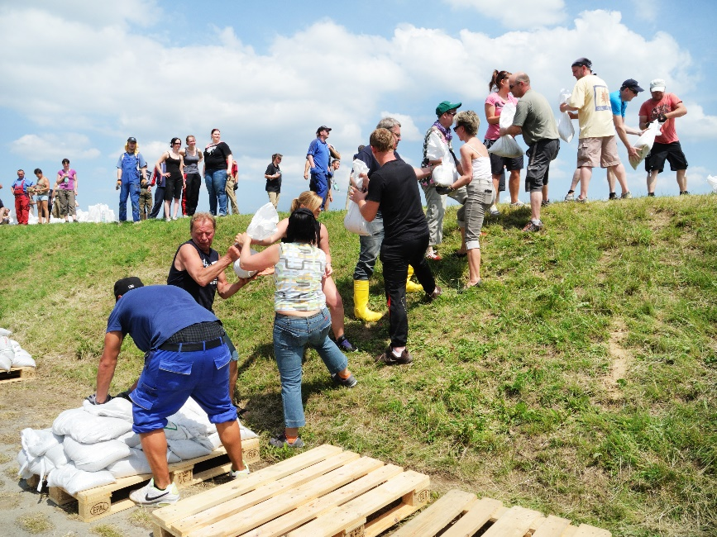
Response
Response: Actions that should be taken during an emergency.
Responding to an emergency means first assessing the situation, and then preventing further damages, injuries, and panic.
Questions that will help you respond to a dangerous situation or emergency:
How can I plan before a crisis?
Do I know what actions to take for a potential emergency?
Is there a family or community plan for reaction that I should know about?
Can I help educate and train people about safety and preparedness?
What resources might be mobilized and needed, and how can I help?

Slide 17
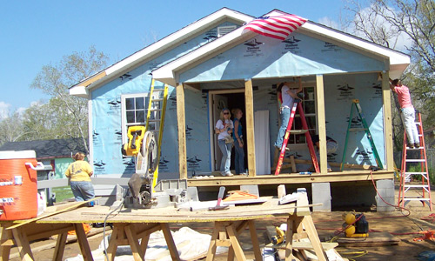
Recovery
Recovery: After a disaster or other emergency, the goal is to try to get things back to “normal.”
In addition to rebuilding and repairing property, there is also work to be done to try to bring physical and emotional health back to a stable condition.
Questions that will help you and your family to recover from a dangerous situation or emergency:
After a disaster, how can I help clean up the damage?
How can I help myself and my family recover emotionally from the disaster?
Do I understand that physical and emotional recovery take time?

Slide 18
Requirement 2
Using a chart, graph, spreadsheet, or another method approved by your counselor, demonstrate your understanding of each aspect of emergency preparedness listed in requirement 2a (prevention, protection, mitigation, response, and recovery) for 10 emergency situations from the list below. You must use the first five situations listed below in boldface, plus any other five of your choice. Discuss your findings with your counselor.
Home kitchen fire
Home basement/storage room/garage fire
Explosion in the home
Automobile accident
Food-borne disease (food poisoning)
Fire or explosion in a public place
Vehicle stalled in the desert
Vehicle trapped in a blizzard
Earthquake or tsunami
Mountain/backcountry accident
Boating accident
Gas leak in a home or a building
Tornado or hurricane
Major flooding or a flash flood
Toxic chemical spills and releases
Nuclear power plant emergency
Avalanche (snowslide or rockslide)
Violence in a public place

Slide 19
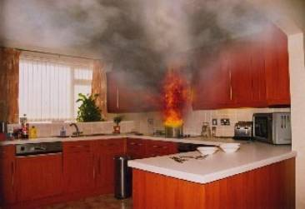
Emergency Preparedness
 | Prevention | Protection | Mitigation | Response | Recovery
2b 1 Home Kitchen Fire | Be careful when using stoves and ovens. Keep loose and flammable materials away from heat sources. | Keep a fire extinguisher near the kitchen. Have a fire response plan in place beforehand. Don’t put water on an oil fire. | Have a plan to evacuate your family. Make sure all doors are closed and walkways are kept clear. | Stay calm and respond quickly. Try to extinguish the fire. If that fails, evacuate and call 911. | Take care of any injuries and file insurance claims. Stay cheerful and support your family.

Slide 20
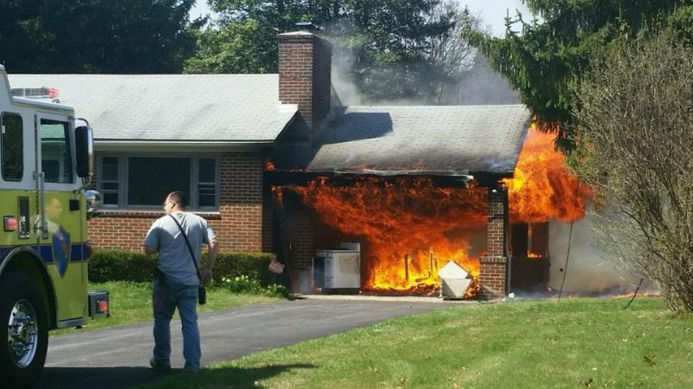
Emergency Preparedness
 | Prevention | Protection | Mitigation | Response | Recovery
2b 2 Home basement, storage room, garage fire | Keep loose debris and flammable materials securely stored. Have multiple fire extinguishers. | Know the location of your home fire extinguisher. Have a response and an evacuation plan. | Notify your family to quickly grab valuables and evacuate. Stay low to avoid breathing smoke. | Close all doors to slow the fire’s spread. Dampen area near the fire, if possible. | Identify relatives or friends to temporarily live with. File an insurance claim.

Slide 21
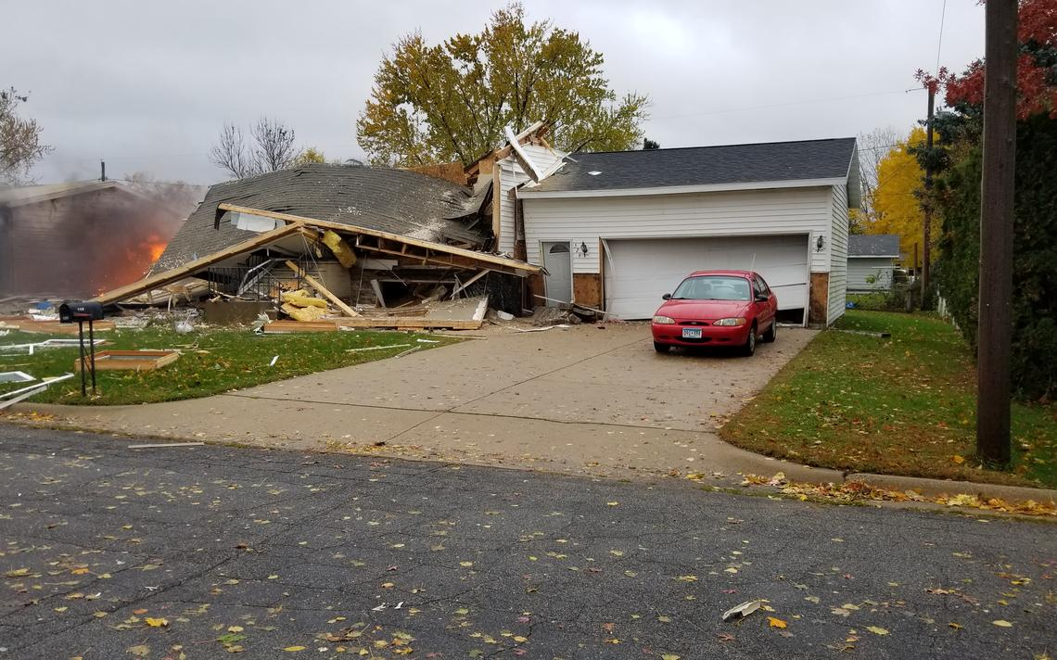
Emergency Preparedness
 | Prevention | Protection | Mitigation | Response | Recovery
2b 3 Explosion in the home | Inspect gas sources regularly. Avoid living near explosives? | Own a fire extinguisher and keep a first aid kit outside the home. | Create an evacuation plan and know first aid. Have emergency numbers posted. | Extinguish small fires and evacuate your family to a safe area. | Work with professions to repair the damage.

Slide 22
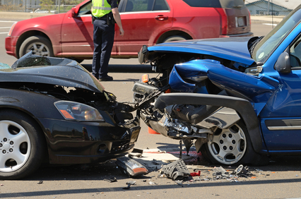
Emergency Preparedness
 | Prevention | Protection | Mitigation | Response | Recovery
2b 4 Automobile accident | Drive under control at all times. Get your vehicle routinely checked by a professional mechanic. Plan your route. | Always wear your seatbelt and keep a first aid kit in your vehicle. Larger vehicles are often safer. | Bring your vehicle off-road after an accident. Call 911. Stay far away from oncoming traffic. | Be alert. Stay calm. Move your family far off-road. Deliver first aid when safe. | Call a reputable towing company. Exchange insurance information with the other driver.

Slide 23
Emergency Preparedness
 | Prevention | Protection | Mitigation | Response | Recovery
2b 5 Food-borne disease (food poisoning) | Toss out spoiled foods. Wash hands. Inspect your food beforehand. Cook foods completely. | Know the symptoms of food poisoning. Be aware of poison control line numbers. | Have fluids with electrolytes in your house. Stop eating if something tastes off. | Tell an adult. Do not take any medications unless approved by a medical professional. | Drink fluids and get lots of rest. Go to a doctor if after 2 days you do not improve.

Slide 24
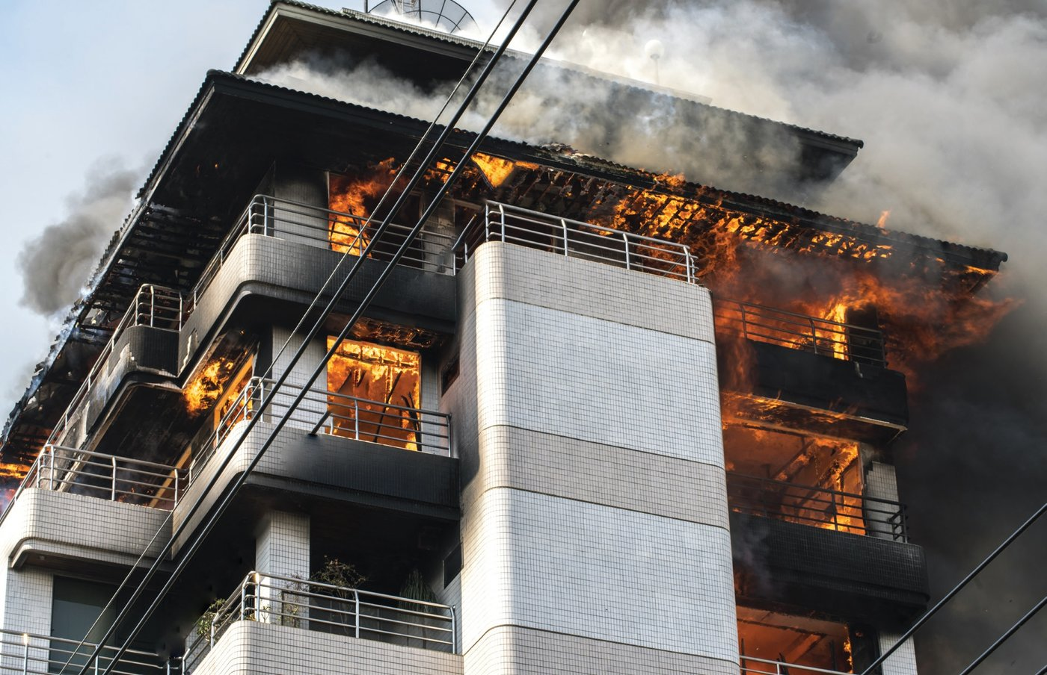
Emergency Preparedness
 | Prevention | Protection | Mitigation | Response | Recovery
2b 6 Fire or Explosion in a Public Place | Report any unsafe condition to a responsible adult. | Look for exits in any public building you enter. | Have a plan to evacuate in the event of an emergency. | Stay calm and don’t panic. Don’t endanger yourself when facing an emergency. Call 911 for help if you can. | Connect with other survivors. Disasters can be traumatizing. Don’t be afraid to seek the help of a psychologist.

Slide 25
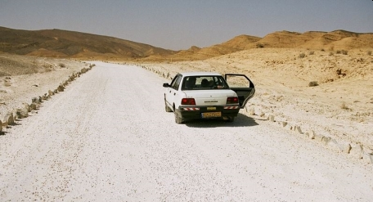
Emergency Preparedness
 | Prevention | Protection | Mitigation | Response | Recovery
2b 7 Vehicle stalled in the desert | Have your vehicle regularly checked. Keep at least 1/3 tank of fuel. Avoid driving in dangerous conditions | Let someone know where you’ll be going. Keep a cell phone and supplies on you at all times. | Carry water and car repair tools. Stay cool and ration your supplies. | Raise the hood and stay near the vehicle and road. Signal distress to passing cars. | Get well hydrated. Treat for heat exhaustion and sunburn. Repair your vehicle at a certified shop.

Slide 26
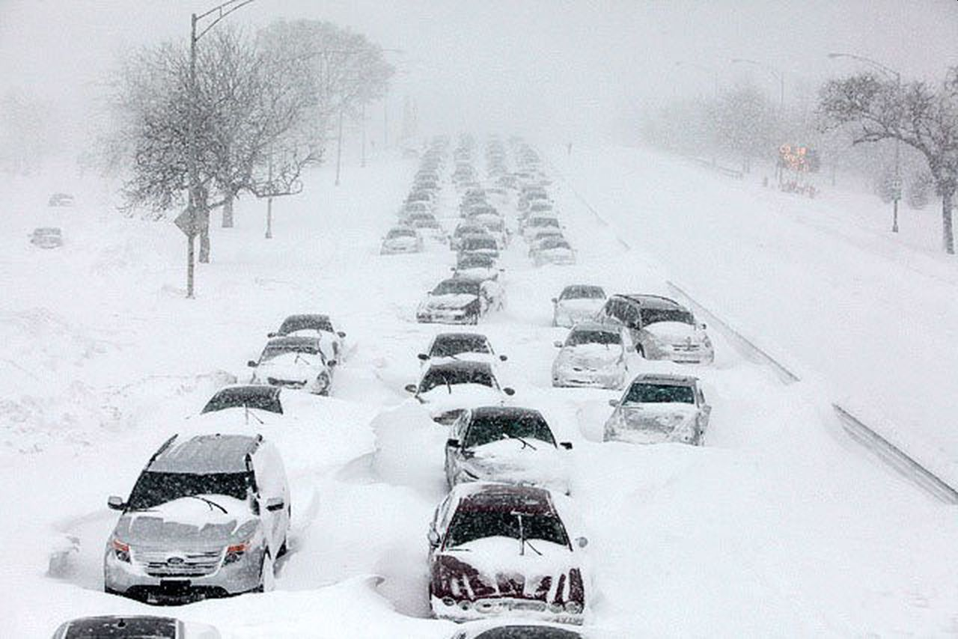
Emergency Preparedness
 | Prevention | Protection | Mitigation | Response | Recovery
2b 8 Vehicle Trapped in a Blizzard | Have your vehicle regularly checked. Keep at least 1/3 tank of fuel. Avoid driving in dangerous conditions | Let someone know where you’ll be going. Keep a cell phone and supplies on you at all times. | Your car should have blankets, snow shovel, signal flares, ice scraper, flashlight with batteries, water, and snacks. | Stay with the car and wait for help. Do not walk in a blizzard as it is easy to lose sight of your car and become lost in the blowing snow. Attract rescuers by flashing hazard lights. If possible, run the engine and heater just long enough to remove the chill (~ 10 min.) | Replace supplies that were consumed.

Slide 27
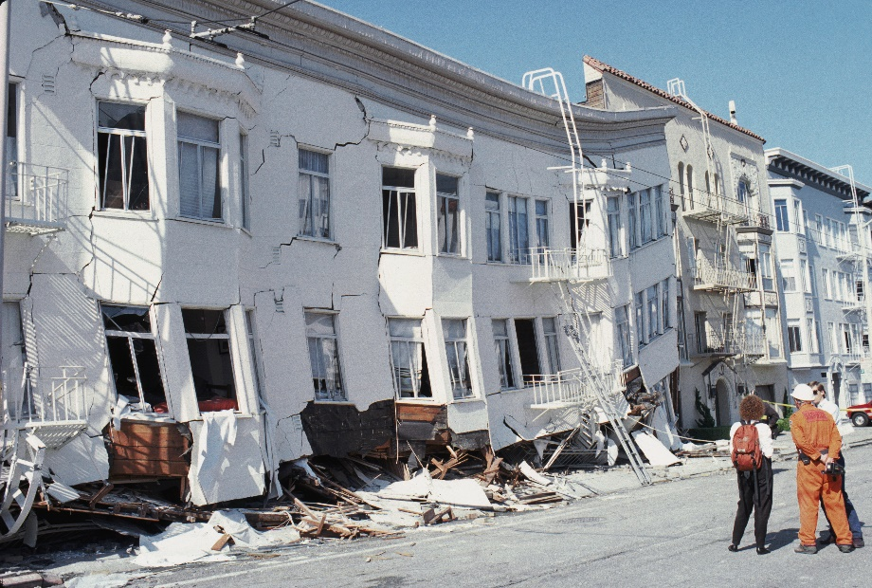
Emergency Preparedness
 | Prevention | Protection | Mitigation | Response | Recovery
2b 9 Earthquake or Tsunami | Find out how earthquake prone your area is and how to be prepared. | Create an emergency kit. Pack food and water to last 2+ weeks. Decide on a family shelter location. | Have a family response plan beforehand. Keep a battery-powered radio. | Stay calm. If indoors, get beneath the nearest table or desk. If outdoors, head for the nearest open area away from buildings and electrical wires. | Check for leaking gas. If you smell gas, get out of the building and call 911. Follow the instructions of community officials.

Slide 28
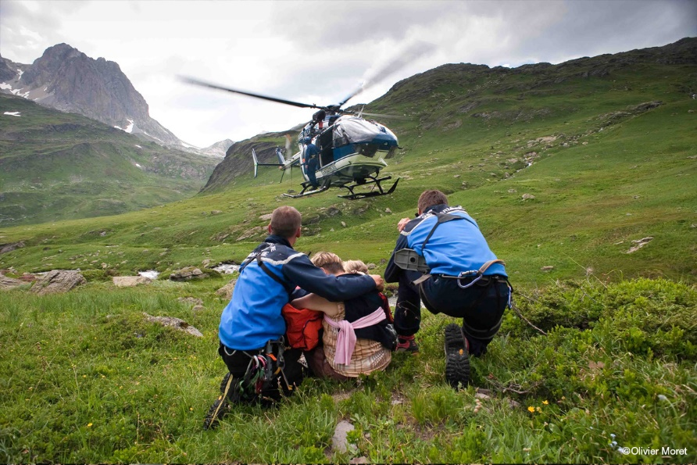
Emergency Preparedness
 | Prevention | Protection | Mitigation | Response | Recovery
2b 10 Mountain or Backcountry accident | Carry a map and cell phone. Inform people of your location beforehand. Tread cautiously on uneven terrain. | Pack reliable survival gear. Bring a first aid kit, food, and water. Understand how to signal a rescue aircraft. | Be in strong physical condition and plan for hazards beforehand. Use the buddy system. Stay within limits. | Signal for help. If lost, remain with the vehicle or in the same place. Ration food and perform first aid. | Repair/replace damaged gear. Take your time to recover. Use what you’ve learned to avoid future accidents.

Slide 29
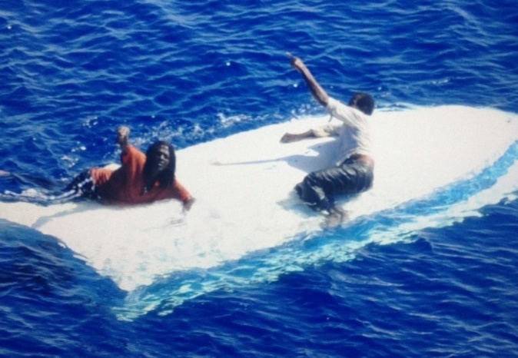
Emergency Preparedness
 | Prevention | Protection | Mitigation | Response | Recovery
2b 11 Boating Accident | Make sure the boat and equipment are in good repair and working order. | Carry fire extinguishers, proper lights, an extra paddle, and an anchor. Know the boat’s capacity and do not exceed it. Everyone should always wear an approved life jacket. Keep a proper lookout when the boat is moving. | Keep an eye on the weather and get back on land before a storm reaches you. Observe the rules for water travel. Know how to signal to others when you are in trouble. | If your boat capsizes, hang on to it unless it is on fire. Wait for help. Do not try to swim for land. In cold water, huddle together in or on the capsized boat to delay hypothermia. | Repair or replace damaged gear. Use what you’ve learned to avoid future accidents.

Slide 30
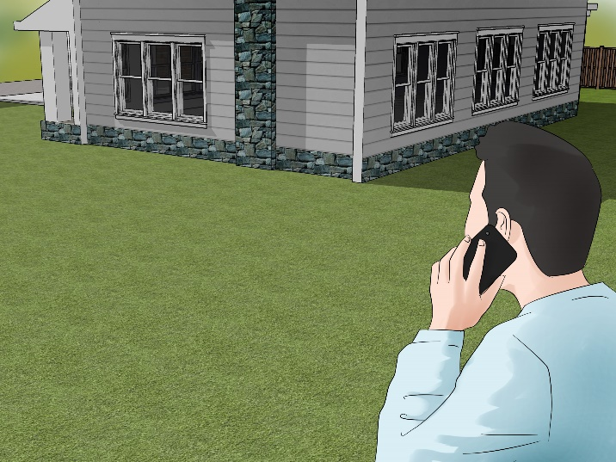
Emergency Preparedness
 | Prevention | Protection | Mitigation | Response | Recovery
2b 12 Gas Leak in a Home or Building | Have gas pipes, fixtures, and appliances inspected regularly and keep them in good repair. | Install carbon monoxide detectors in the building. Know what a gas leak smells like. Know how to shut off the gas to the building. | Do not look for the source of the leak. If someone is overcome by gas fumes, get the person outdoors into fresh air. | Evacuate everyone from the building. Call 911 from a cell phone or a neighbor’s phone if you think you have a gas leak. | Repair or replace damaged fixtures or appliances. Use what you’ve learned to avoid future accidents.

Slide 31
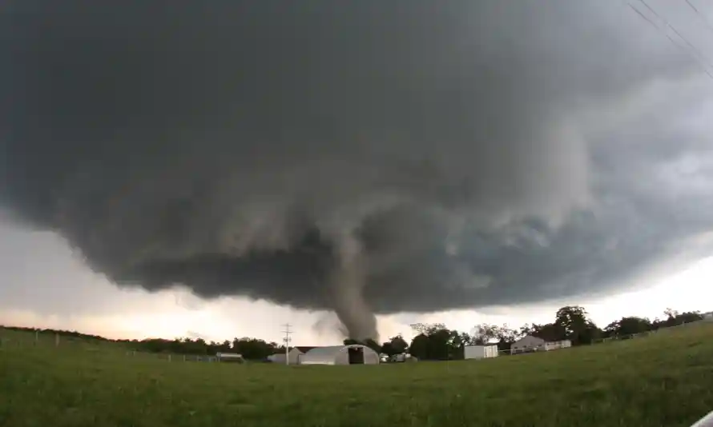
Emergency Preparedness
 | Prevention | Protection | Mitigation | Response | Recovery
2b 13 Tornado or hurricane | Find out how prone your area is to tornados or hurricanes and how to be prepared. | Create an emergency kit. Pack food and water to last 2+ weeks. Decide on a family shelter location. | Have a family response plan beforehand. Keep a battery-powered radio. | Avoid glass or nearby windows. Evacuate quickly. Make sure everyone is accounted for. | Clean up any debris around your house. Beware of standing on unstable structures. Contact your insurance.

Slide 32
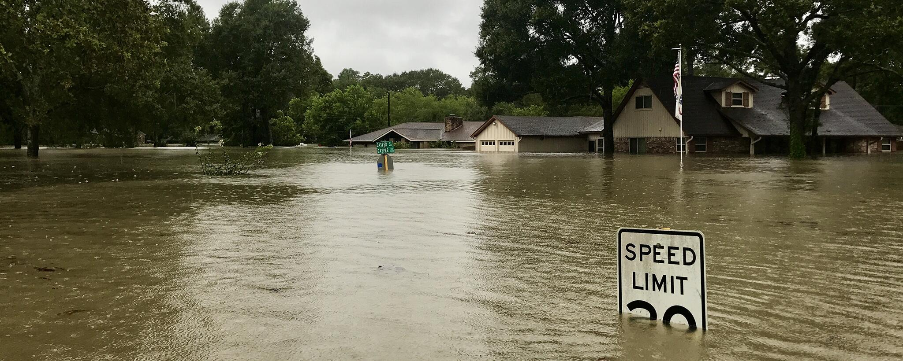
Emergency Preparedness
 | Prevention | Protection | Mitigation | Response | Recovery
2b 14 Major flooding or a flash flood | Do not live in areas that historically have been flooded. Keep sandbags at home. | Keep all valuable in a secure, waterproof spot. Sandbag your home. Evacuate if it’s recommended. | Avoid driving in floodwaters. Keep emergency food and water in your home. | Listen to the radio for flooding zones and evacuate to a safe location. Avoid entering floodwaters. | Return home only when completely safe. Wear heavy boots and gloves during cleanup. Be aware of electrocution risks.

Slide 33
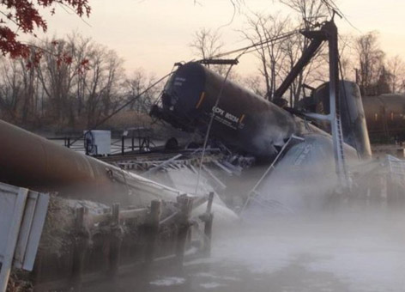
Emergency Preparedness
 | Prevention | Protection | Mitigation | Response | Recovery
2b 15 Toxic chemical spills and releases | Find out what toxic chemicals are manufactured or stored in your area and how to be prepared in the event of a spill or release. | Find out about the local government’s response program for hazardous materials spills and releases. Know what the community warning system is to notify residents when an emergency occurs. | Evacuate when told to. If directed to shelter in place, go inside and close all doors and windows. Turn off any ventilation systems that draw in outside air. | If anyone is feeling ill, having trouble breathing, or complaining of burning sensations, get them to the hospital. | When local authorities declare the event over and it is safe, you can go about your normal business.

Slide 34
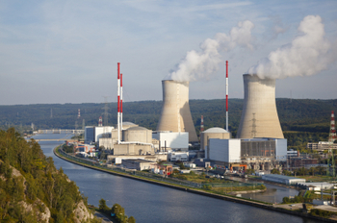
Emergency Preparedness
 | Prevention | Protection | Mitigation | Response | Recovery
2b 16 Nuclear Power Plant Emergency | Find out if a nuclear power plant is in your area and how to be prepared in the event of an emergency. | Find out about the local government’s response program nuclear emergencies. Know what the community warning system is to notify residents when an emergency occurs. Know evacuation routes. | Evacuate when told to. If directed to shelter in place, go inside and close all doors and windows. Turn off any ventilation systems that draw in outside air. Stay until you are told it is safe to leave | Stay calm. When outdoors, cover your nose and mouth with a handkerchief. When you go back indoors, change your clothes and shower. Dispose of clothing in a sealed plastic bag. | Authorities will monitor radiation release and will let the public know when any danger has passed.

Slide 35
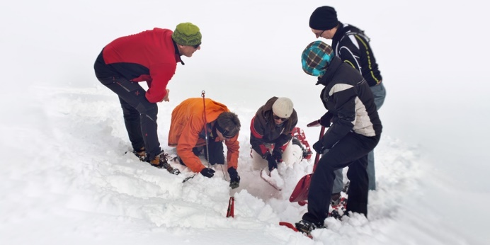
Emergency Preparedness
 | Prevention | Protection | Mitigation | Response | Recovery
2b 17 Avalanche (Snowslide or Rockslide) | Avoid places where snowslides or rockslides might occur. | Avoid climbing or skiing in dangerous high country without an experienced guide. Stay out of the mountains after heavy snowfall. Do not hike, stand, or camp in the fall zone of a cliff. If traveling in mountainous areas, carry a rescue beacon. | Experienced alpine skiers tie a 30-yd. red cord to the belts and trail this behind them as the ski. If they are caught in a snowslide, the cord will float to the surface where rescuers can spot it. | If you are caught in a snowslide, move your arms and legs in a swimming motion to try to keep your head above the surface. Push snow away from your face to form an air pocket that will allow you to breathe. | If you see someone caught in a snowslide, watch carefully so you will be able to tell rescuers the general area where they disappeared. Keep an eye out for a second slide which often follows the first.

Slide 36
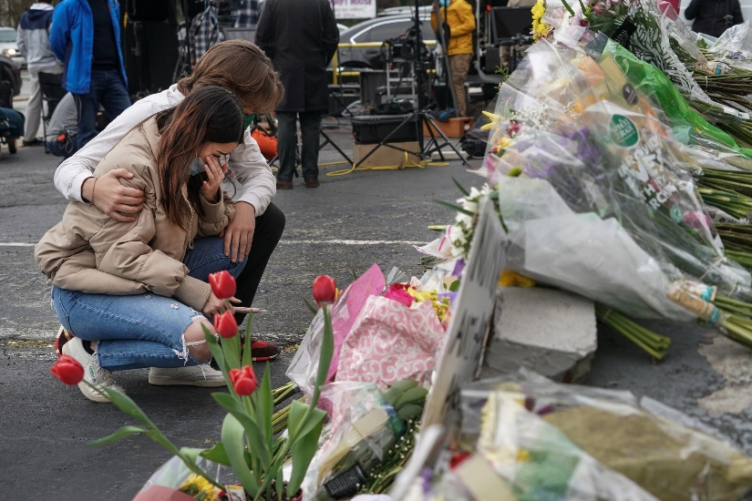
Emergency Preparedness
 | Prevention | Protection | Mitigation | Response | Recovery
2b 18 Violence in a public place | Be on the lookout for suspicious or aggressive behavior. If you see something, say something to an authority. | Identify exits and places to seek cover. Place a solid object between you and the attacker. Be ready to run quickly. | Wear reliable footwear and clothing that doesn’t restrict movement. Stay in good physical condition. | Call 911. Evacuate quickly but avoid trampling others. As a last resort, incapacitate the attacker by striking the eyes, ears, or groin. | Connect with other survivors. Attacks can be traumatizing. Don’t be afraid to seek the help of a psychologist.

Slide 37
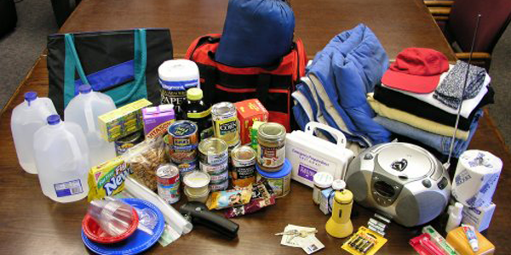
Requirement 2
Meet with and teach your family how to get or build a kit, make a plan, and be informed for the situations on the chart you created for requirement 2b. Complete a family plan. Then meet with your counselor and report on your family meeting, discuss their responses, and share your family plan.

Slide 38
Emergency Supply Kit
Keep a box of emergency supplies to meet your family’s needs for a few days or a week.
Some of the things you’ll need in your emergency supply kit include:
Water (1 gallon per day, per person)
Food (Non-perishables like MRE’s, canned goods, dried foods)
A can opener
Eating utensils
A first aid kit
A flashlight
A radio
Matches in a waterproof container
Blankets
Extra clothing
Dust masks
Soap, wipes, or antibacterial gel
Toilet paper
Emergency toilet
Prescription medication
Batteries
Important documents and insurance
Cash and coins
Books, games, and other personal comfort items
A whistle
Sunscreen and insect repellant
Trash bags

Slide 39
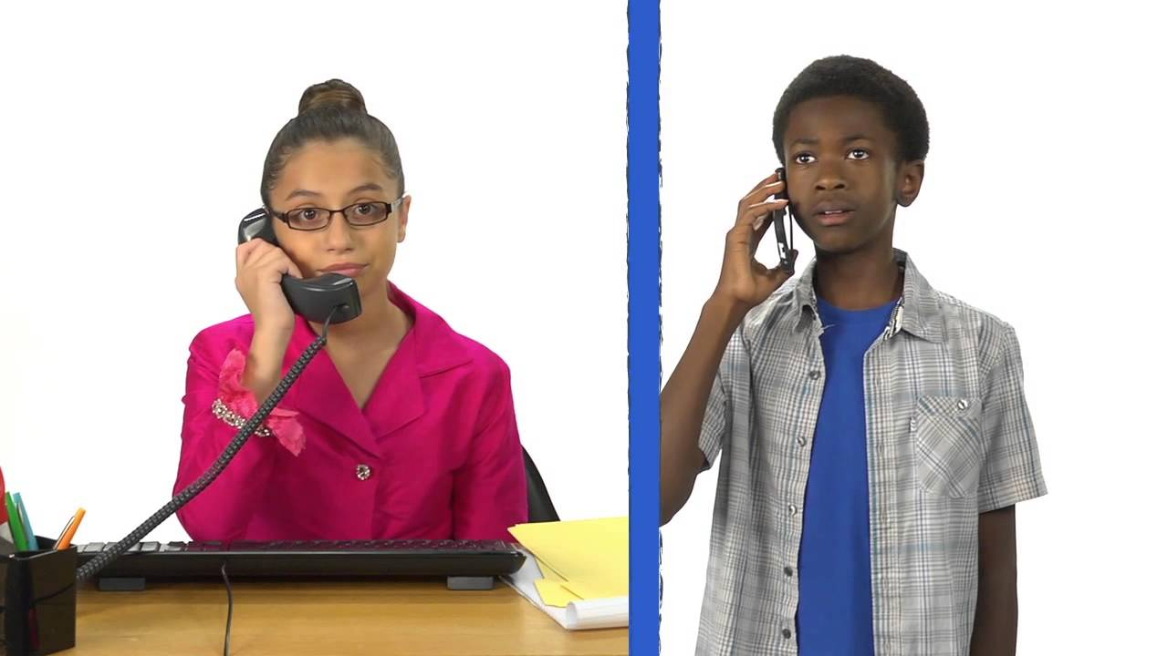
Family Emergency Plan
In this, your family will decide on what to do and where you’ll all meet if an emergency occurs.
To learn how to write your family emergency plan, watch the official FEMA planning video by clicking on the picture below:

Slide 40
Requirement 3
Show how you could safely save a person from the following:
Touching a live household electric wire.
A structure filled with carbon monoxide
Clothes on fire.
Drowning using nonswimming rescues (including accidents on ice).

Slide 41
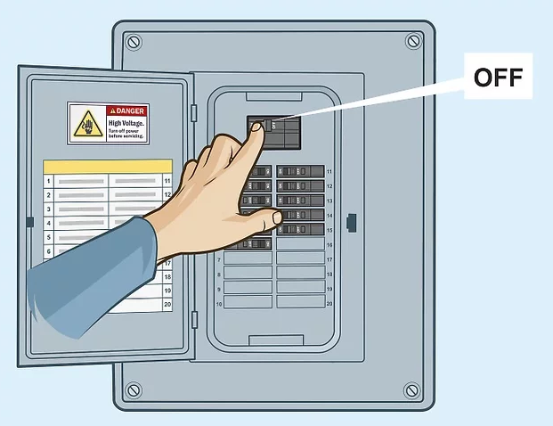
Requirement 3
If someone is in contact with a live circuit, do not touch the person. You can become “stuck” to him and part of the electrical field.
If the service panel is nearby, quickly shut off the house current by throwing the main circuit breaker.
If it is a long way to the service panel, or you do not know where the panel is, use a non-conducting object such as a wooden chair, wooden broom handle, rug, or rubber doormat to separate the person from the live wire.
Never use a metal or wet object.
If the person is not breathing after the rescue, call 911 for medical assistance and start CPR immediately.

Slide 42
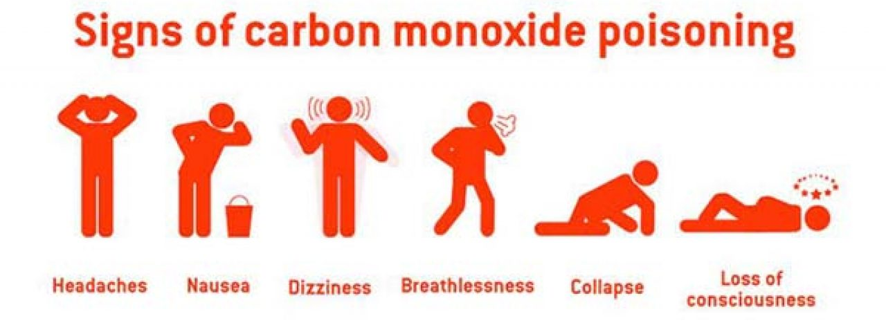
Structure Filled with Carbon Monoxide (CO)
Carbon monoxide is a colorless, odorless gas that is toxic when inhaled.
Gas fired machinery such as cars, generators, and ovens create carbon monoxide as a byproduct when used.
If you or someone else exhibits the above symptoms, get outside or open windows right away for fresh air.
If someone is overcome by carbon monoxide poisoning, call 911 and give rescue breathing if necessary.
Turn off any source of combustion, and evacuate the building.
To protect your family, install a CO detector in your home close to where you sleep.
This detector will emit a loud sound, alerting you if there are unsafe levels of carbon monoxide in the building.

Slide 43
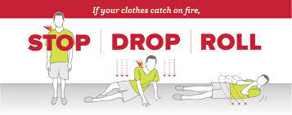
Clothes on Fire
A person whose clothes are on fire should immediately stop, drop, and roll:
Stop: Running adds oxygen to the fire and could cause the flames to spread. Immediately freeze in place.
Drop: Gently bring yourself to the ground to avoid further injury. Spread yourself out lengthwise so that a large portion of your body is in contact with the ground.
Roll: While covering your face with your hands, roll side to side in a motion that will smother the flames. Continue until the fire is completely extinguished.
If you witness this type of emergency, help to extinguish the fire if you have water or a non-flammable safety blanket on hand.
Seek emergency medical attention immediately.

Slide 44
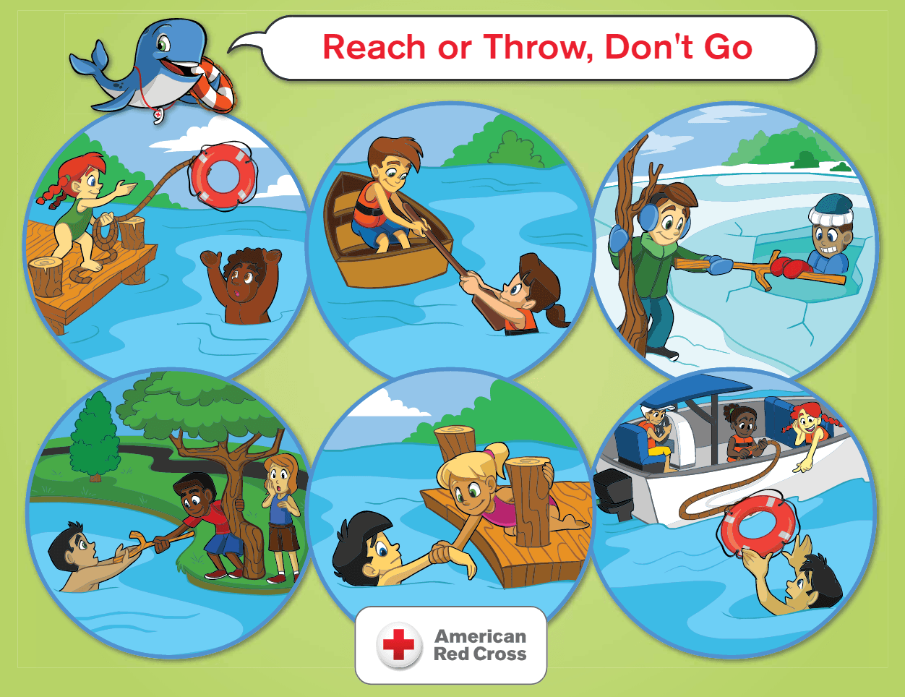
Drowning Using Non-Swimming Rescues
If you see someone who is in the water and needs help, use a reaching, throwing or rowing assist to help the victim.
You should never endanger yourself by going into the water and swimming out to the victim unless you are trained to do so.

Slide 45
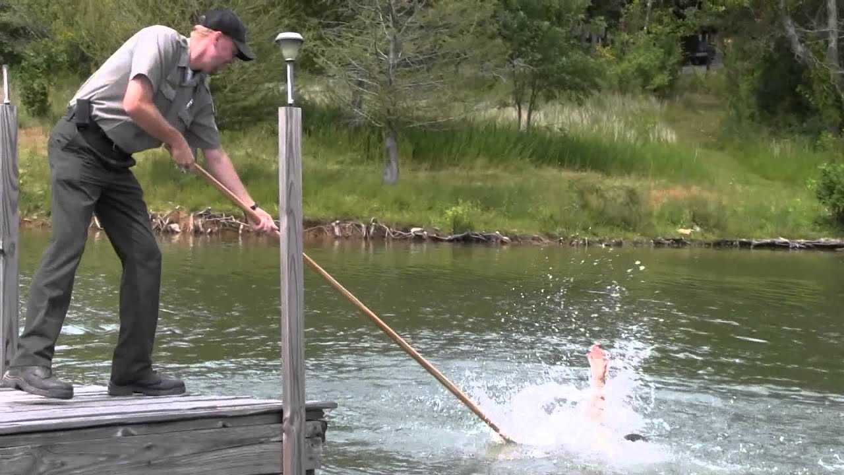
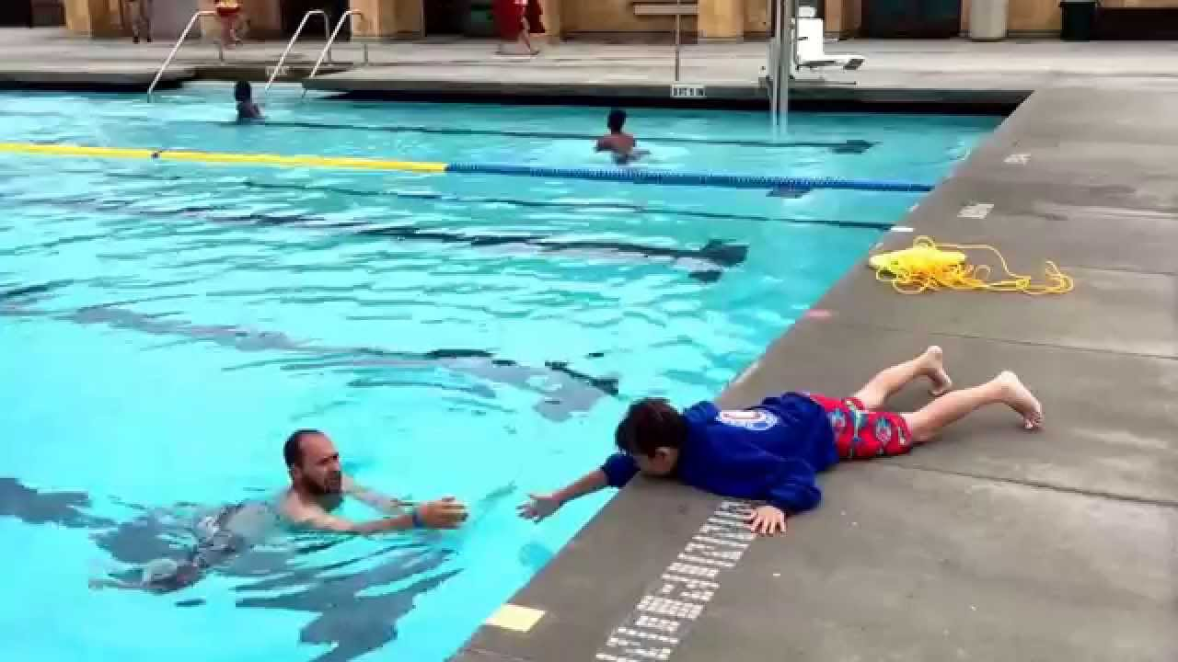
Drowning Using Non-Swimming Rescues
Reaching Rescue
Reach with anything you can: your leg or arm, a broom, branch, paddle, pole.
Lying down on or otherwise bracing yourself from a dock or solid ground, reach to the victim with something that can be grabbed onto.
Pull the person to shore.

Slide 46
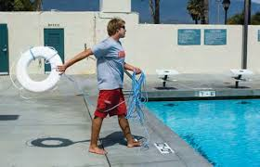
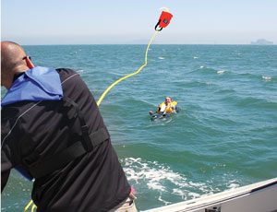
Drowning Using Non-Swimming Rescues
Throwing Rescue
Throw help to a victim if the person is out of reach.
Most protected beaches and pools have ring buoys attached to a line ready for use.
Anything that floats well enough to support someone will help, even if it doesn’t have a line attached – life jackets, float cushions, inner tubes, kickboards, empty water jugs, coolers, etc.

Slide 47
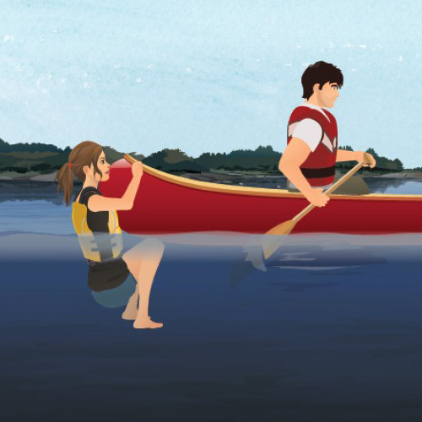
Drowning Using Non-Swimming Rescues
Rowing Rescue
Row to a person in trouble if you cannot reach or throw help.
When you get near the victim, row backward to the victim to allow the person to grasp the back of the boat.
Once the person has calmed down, decide whether to tow the person a short distance to shore or to carefully help the person aboard over the back end of the boat.

Slide 48
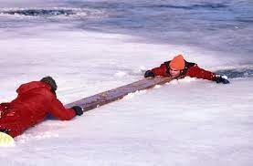
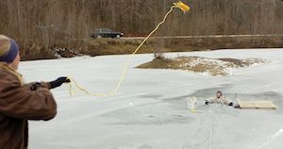
Ice Rescues
Reach out to the person with a pole, tree branch, ladder – anything that will reach. Push it over the ice so that the person can grab it.
Throw a rope to the person if you can. Put a loop (bowline) in the end of the rope so the victim can slip it over themselves.
If you cannot reach or throw, move spread-eagle over the ice and wiggle your way to the person. Once you get closer, reach to the person with something long. You want to go out on the ice as little as possible.
After you rescue someone from ice water, get them indoors right away. Hypothermia can create another emergency.

Slide 49
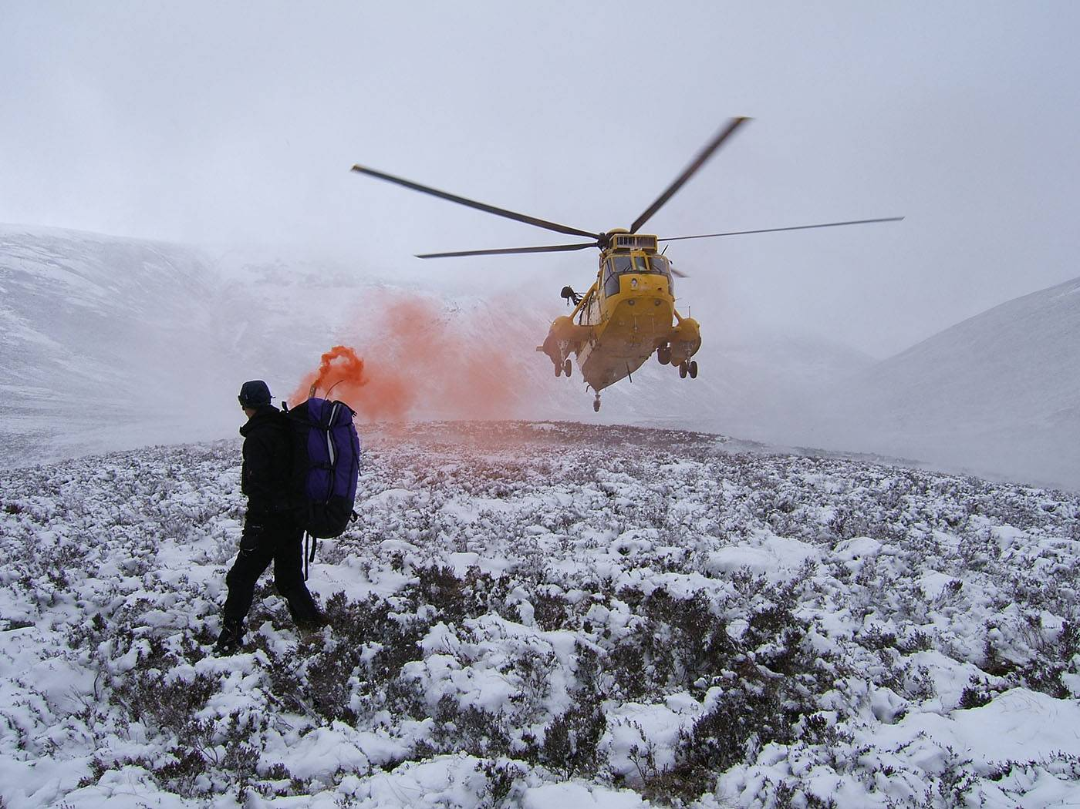
Requirement 4
Show three ways of attracting and communicating with rescue planes/aircraft.

Slide 50
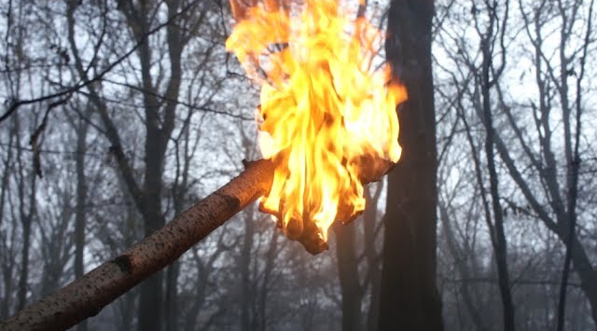
Signal a Rescue Aircraft
There are many different ways you can attract the attention of a passing aircraft when lost in the wilderness.
Some methods include signal fires, mirrors to reflect light, and large distress signals drawn on the ground.
Click on the picture below to watch a video on various ways to signal a rescue aircraft.

Slide 51
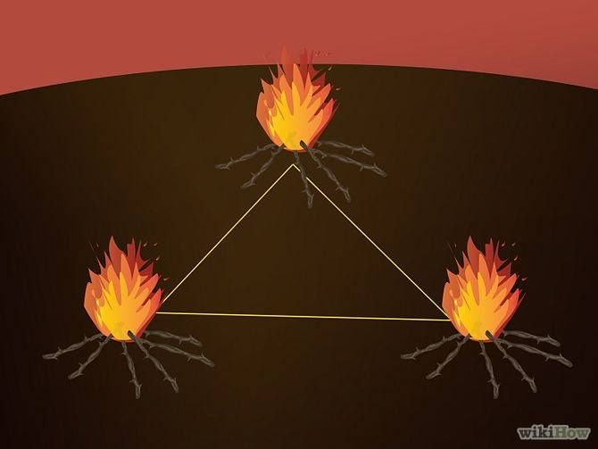
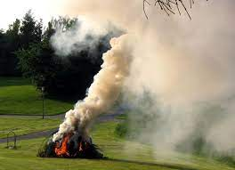
Plane Signals
Three of anything – visual or audible – repeated at regular intervals is a distress signal.
Three fires arranged in a tringle convey a universal SOS.
Build fires in an open area where they can be seen.
Keep a pile of fuel (brush, twigs, leaves) nearby so that you can quickly make the fires bigger.
During the day, use green wood, or damp leaves to produce visible smoke.

Slide 52
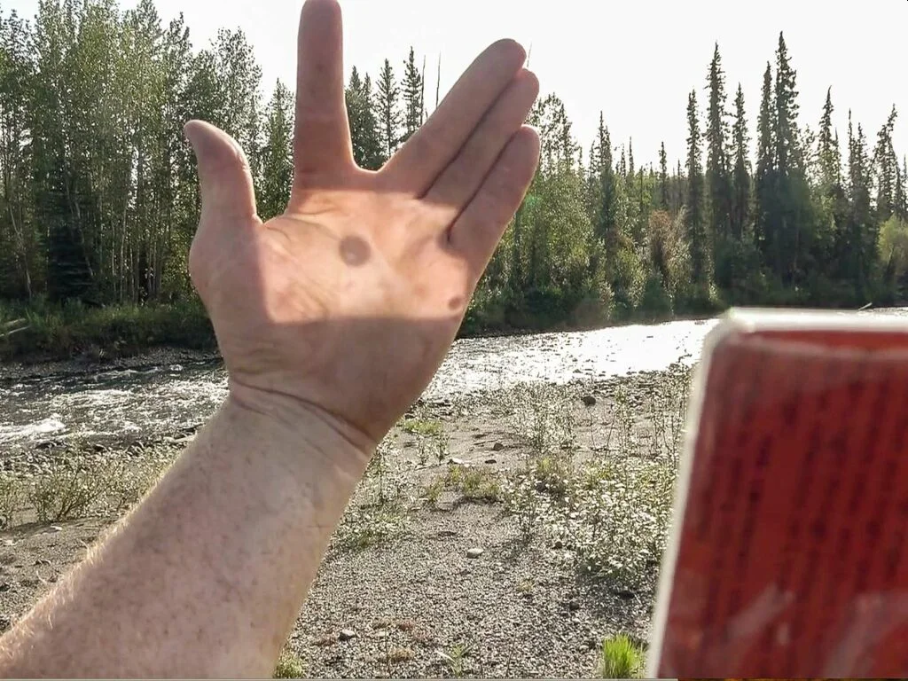
Plane Signals
How to Use a Signal Mirror
Facing the sun, place the mirror next to your eye—or, if it has a sight, hold the mirror right up to your eye to peep through the hole—and then look toward the sun.
Stretch out your other arm in front of you and tilt your head down until you can see the reflection of the mirror on your hand.
Spread open two fingers to create a V and guide the reflected light between them. Keep a small portion of the reflection visible on your fingers so you know it’s there.
Place your target between your two spread-out fingers while angling the mirror so that the reflected light remains between them.
Once the directed light is fixed on your target, flash the mirror up and down three times quickly. Three represents the universal distress signal, and flashing is also more attention-grabbing than direct light.

Slide 53
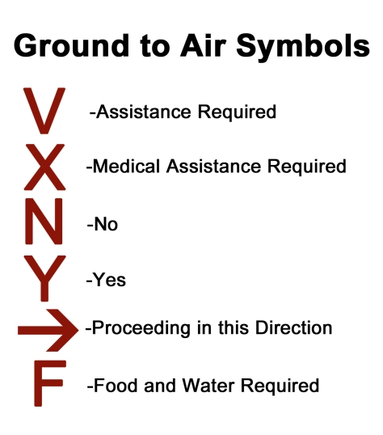
Ground to Air Symbols
Ground-level symbols can attract an aircraft and communicate with the pilot.
Make the symbols with strips of cloth, rocks, or branches.
Use any available material that will contrast with the background.
Make the symbols big – 10 feet wide or wider – in an open area where they can be seen.
When is doubt, use the international distress symbol, SOS.

Slide 54
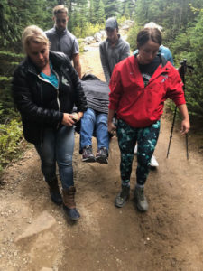
Requirement 5
With another person, show a good way to transport an injured person out of a remote and/or rugged area, conserving the energy of rescuers while ensuring the well-being and protection of the injured person.

Slide 55
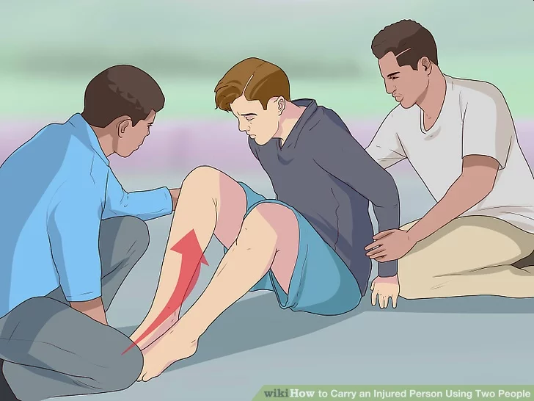
Method 1: Using the Human Crutch
Assist the injured person to his feet.
Once the injured person is ready and able, help the person to stand up.
If not, lift the person to his feet by grasping clothing items.
Give the person as much time as he needs to stand up, as long as there isn't any other immediate danger.
As with sitting, this can help stabilize his blood pressure and help prevent unnecessary falls.
If the person is not able to place either a foot or both his feet on the ground, you may need to offer a little bit more support.
Remove as much of the weight from his leg or legs as possible in this case.

Slide 56
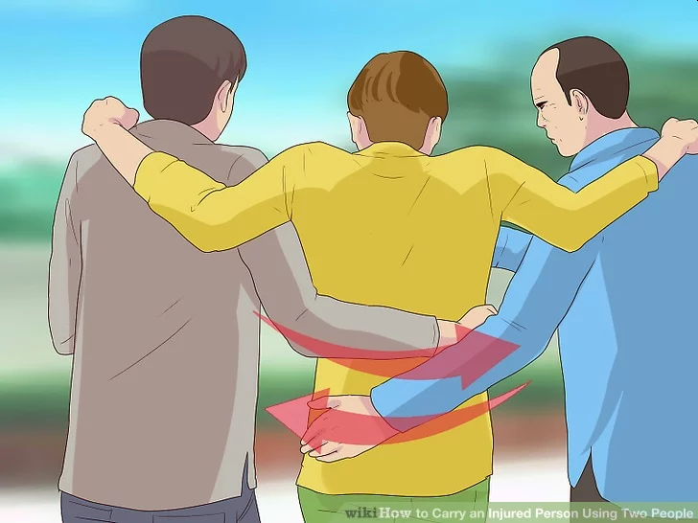
Method 1: Using the Human Crutch
Wrap your hands around the injured person's waist.
Once the person is standing, place your hands around the waist of the injured person.
As you begin to move out the person, this can add an extra measure of security while assisting the person.
If the person is unconscious, grasp her belt or waistband.
Pull on it slightly to lift the person's upper body.

Slide 57
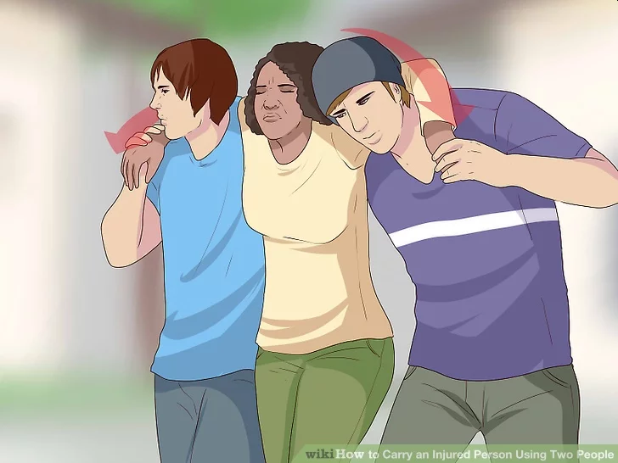
Method 1: Using the Human Crutch
Place the injured person's arms over your shoulder.
Squat down slightly and put the person's arms over your shoulder and that of your fellow rescuer.
This should place you in the same direction as the injured person.
The rescuers should use their legs to stand up with the injured person. Make sure to do this slowly to maintain stability of the grasp.
Ask the person if he is still ok and ready to move.
Don't rush the person — give him plenty of time to stand up.

Slide 58
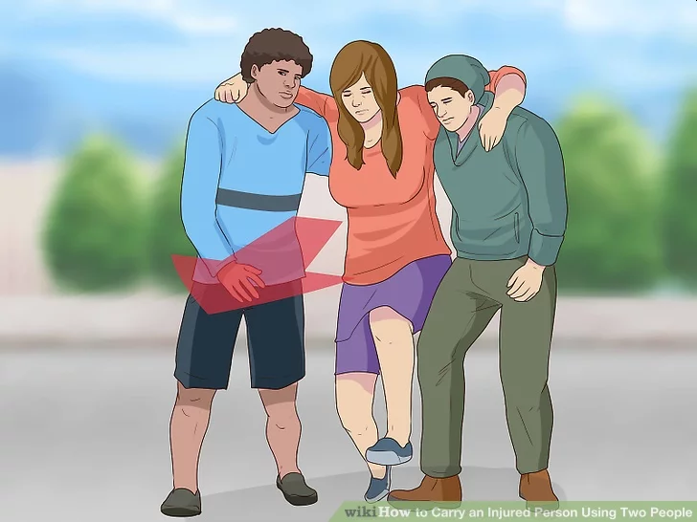
Method 1: Using the Human Crutch
Move out with the injured person.
Once everyone is standing and facing the same direction, you are ready to move out with the injured person.
Make sure to check that the person is secure either by asking her or checking with your fellow rescuer if the person is unconscious.
This cannot only help ensure that you don't drop or jostle the person, but also help you more effectively remove the injured party from the situation.
The person's legs should be dragging behind you and your fellow rescuer.
Make sure to make slow and deliberate movements when dragging out the person to help ensure safety.

Slide 59
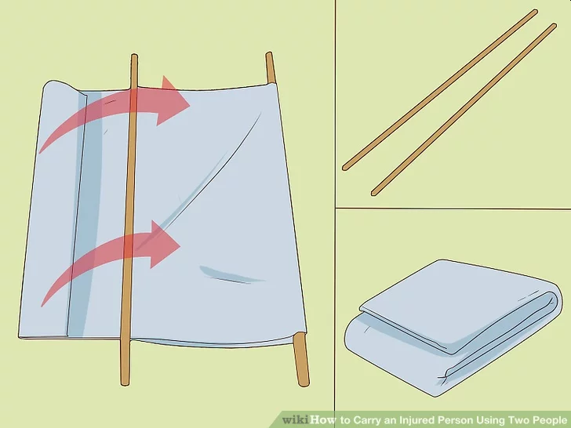
Method 2: Improvised Stretcher
Improvise a stretcher to carry the injured person.
If person is unconscious or unstable, make a stretcher to carry the person. You can use two poles or some blankets or improvise a stretcher out of whichever materials you have available. Find two sturdy poles, tree branches or other straight pole-like objects and place them parallel on the ground.
Take a cloth roughly three times as big as the stretcher should be and lie it on the ground. Put a sturdy pole a third to half of the way along the cloth; fold the section over the pole.
Set the other pole on the two pieces of cloth, leaving enough room for the injured person and enough cloth to fold over this second pole.
Fold the cloth over the pole so that at least one foot of cloth encases the second pole. Take the rest of the cloth and fold it over your poles again.

Slide 60
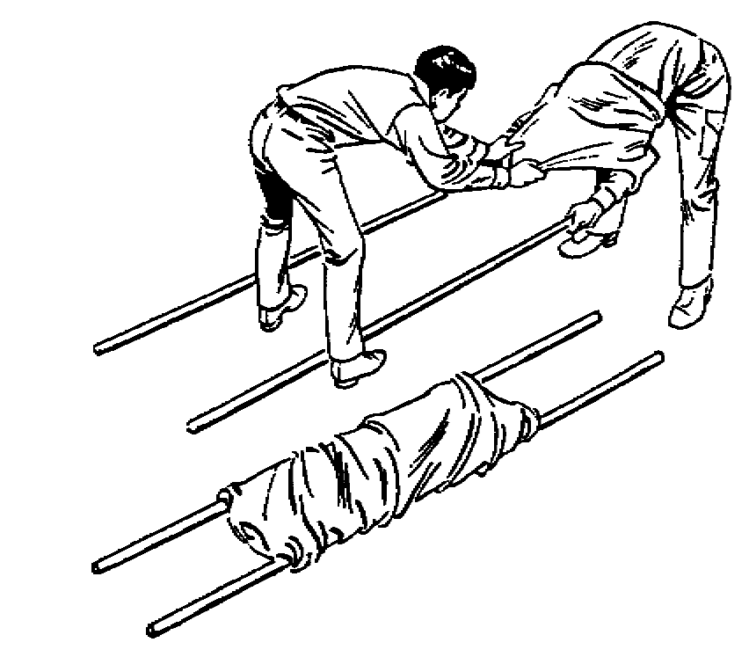
Method 2: Improvised Stretcher
If you don't have a large cloth or blanket, use shirts, sweatshirts, or any other cloth you may have available. Do not give up your clothing if this will in any way hamper your ability to assist the person.
Check to make sure that the stretcher you've fashioned is as secure as possible so that you don't drop the person.

Slide 61
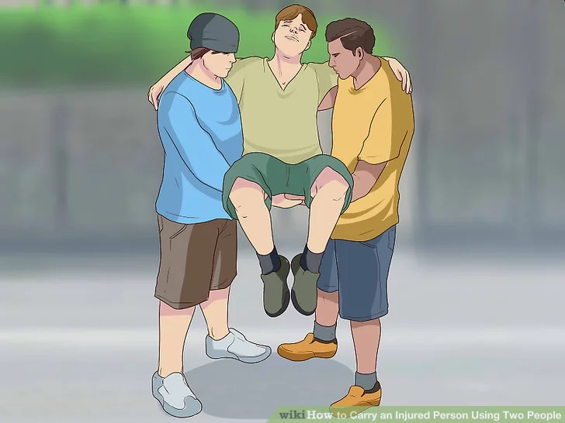
Method 3: Two Handed Seat Carry
A two-handed seat is most useful for carrying people longer distances or for supporting an unconscious person.
Squat down on either side of the person.
Slide one arm under her shoulders, resting your hand on the shoulder of your partner.
Slide your other arm under the knees of the person and grasp the other rescuer's wrists.
Lift up from squatting, lifting from your legs and keeping your back straight, and begin moving forward.

Slide 62
Requirement 6
Take part in an emergency service project, either a real one or a practice drill, with a Scouting unit or a community agency.

Slide 63
Emergency Service Project
Lost Child Project
Scouts are often called on to help find people who are lost and you can help train your troop on how to do it.
Scouts are called together through a troop mobilization plan.
For the project, make a “lost child” dummy from a burlap sack stuffed with straw.
Put a shirt on it so that the searchers will recognize it along with a card outlining minor injuries they will have to treat.
Before the mobilization call, place the dummy somewhere in the search territory.
Position it an area that will prove challenging.
Test the searchers’ powers of observation by planting some barely noticeable “evidence” (such as clothing) of the lost child.
After the Scouts have been assembled by the mobilization call, organize them into search parties and use the lost person search method found on the next two slides.
Mark the search area on maps that are distributed to the scouts.
Agree on recall signals so the search does not continue after the lost child has been found.
Once found, the lost child should be properly treated for any injuries and transported safely to the starting point.

Slide 64
Emergency Service Project
Lost Person Search Method
Three teams begin searching an area between a road and a trail.
Team 1 lays ribbon lines (dotted lines) at the edges of its search lanes.
Teams 2 and 3 pick up the ribbons and move them to the edges of their search lanes as they begin searching. The area behind the teams is therefore clearly identified as having been searched.
The area outside the ribbons is identified for the “pivot” and continuing search pattern.

Slide 65
Emergency Service Project
Lost Person Search Method
The three teams pivot to continue the search.
They move to the sides (shown by the dotted arrows) to the outside of the ribbons.
Teams move the ribbons again to the outside of the search pattern.
As they continue “sweeping” in this way, the searched area will expand farther to the left and right.

Slide 66
Requirement 6
Prepare a written plan for mobilizing your troop when needed to do emergency service. If there is already a plan, explain it. Tell your part in making it work.

Slide 67
Mobilization Plan
Plan A
This plan involves planning and making contacts on the basis of proximity, or nearness.
Under this plan, when the Scoutmaster has been contacted by an authorized person requesting the troop’s services, the Scoutmaster goes to the home of a member in one direction from the scoutmaster’s home, and then to the home of a member in another direction.
In a similar manner, each Scout personally contacts one or two members of the troop.
This process continues until all have been notified.
Scoutmaster
Authorized Person

Slide 68
Mobilization Plan
Plan B
Use this plan when normal phone communications are available.
Troops mobilize by patrols.
To begin, the Scoutmaster calls the assistant Scoutmaster and the senior patrol leader.
They each phone two patrol leaders.
The patrol leaders each phones two patrol members.
This procedure continues through the entire troop roster.

Slide 69
Requirement 7
Describe the National Incident Management System (NIMS) and the Incident Command System (ICS)

Slide 70
National Incident Management System (NIMS)
The purpose of the National Incident Management System is to provide citizens with a routine that can be used by the whole community for managing emergency situations.
This systematic approach helps guide individuals groups. And government agencies in working together to cope with a range of threats and hazards.
The principal goal is to prevent loss of life, reduce property damage, and avert harm to the environment.
By using NIMS, communities can more effectively respond to and manage emergency situations and utilize resources such as personnel, food, water, and shelter more efficiently.

Slide 71
Incident Command System (ICS)
The Incident Command System (ICS) is a system that efficiently manages emergency personnel during disasters.
Its main purpose is to develop a consistent chain of command that includes a diverse range of government and non-governmental organizations.
In an emergency, the ICS puts a system in place where many different types of personnel can quickly begin work under the same command.
ICS ensures that the most pressing needs are met, and that precious resources are used without duplication or waste.

Slide 72
Requirement 7
Identify the local government or community agencies that normally handle and prepare for emergency services similar to those of the NIMS or ICS. Explain to your counselor
How the NIMS/ICS can assist a Boy Scout troop when responding in a disaster
How a group of Scouts could volunteer to help in the event of these types of emergencies.

Slide 73
FEMA
The Federal Emergency Management Agency (FEMA) is an organization in charge of preparing for and responding to, disasters.
Created under the department of homeland security, FEMA operates sub-agencies in all 50 states.
You can view FEMA’s official website to locate the FEMA agencies and offices within your own state.

Slide 74
Wood County Emergency Management Agency
Website Link: Wood County Emergency Management Agency
Wood County Courthouse & Office Building One Courthouse Square Bowling Green, Ohio 43402
Office Hours: Monday - Friday 8:30 a.m. – 4:30 p.m.
Office Phone: 419-354-9269
Office Email: woodcountyema@woodcountyohio.gov

Slide 75
American Red Cross
The American Red Cross is a humanitarian organization which provides relief to victims of disasters and helps people prepare for, respond to, recover from and prevent emergencies.
Visit the website of The American Red Cross of Northwest Ohio for more information.

Slide 76
Disaster Response and Scouts
In 2003, FEMA established a partnership with Scouts BSA to operate under NIMS and ICS protocol in the case of an emergency.
Following Hurricane Katrina in 2006, scouts living in the Gulf Coast region worked with local agencies to distribute resources and provide hurricane relief efforts.
By coordinating with law enforcement and emergency response personnel, scout troops can mobilize during disasters to help their communities.

Slide 77
Requirement 7
Find out who is your community's emergency management director and learn what this person does to prevent, protect, mitigate, respond to, and recover from emergency situations in your community. Discuss this information with your counselor, utilizing the information you learned from requirement 2b

Slide 78
Wood County Emergency Management Agency
You can find out who your community emergency management director is by visiting the following website: Wood County Emergency Management Agency
Wood County Courthouse & Office Building One Courthouse Square Bowling Green, Ohio 43402
Office Hours: Monday through Friday 8:30 a.m. – 4:30 p.m.
Office Phone: 419-354-9269
Office Email: woodcountyema@woodcountyohio.gov

Slide 79
Emergency Management Director
The role of an emergency management director is to prepare plans and processes to contain disasters.
These individuals lead response efforts during and after emergencies, using the ICS method to coordinate elected officials, medical teams, government agencies, and safety personnel.
Emergency management directors must assess hazards and create contingency plans beforehand, coordinate teams during an emergency, streamline efforts to reduce potential casualties, and later, review response efforts.

Slide 80
Requirement 8
Tell the things a group of Scouts should be prepared to do, the training they need, and the safety precautions they should take for the following emergency services:
Crowd and traffic control
Messenger service and communication.
Collection and distribution services.
Group feeding, shelter, and sanitation.

Slide 81
Crowd and Traffic Control
Crowd and traffic control must be done under the supervision of officials in charge of the situation.
The crowd-control crew should have caution tape.
To move a crowd back, crew members can use the caution tape, held at chest height, and advance slowly toward the crowd.
To keep the crowd back, form a chain with other staff members.
To direct the movement of a crowd, indicate direction by pointing or blocking the way.
During daylight hours, a fluorescent or reflective vest should be worn.
After dark, a reflective vest should be worn.

Slide 82
Messenger Service and Communications
Messenger Service
Your troop should make a large-scale map of the are and assigns sections to each patrol.
Each patrol prepares its own sectional map and learns it inside out.
Bikes can speed up delivery.
During emergencies, it is essential that each messenger carry personal identification, a list of critical phone numbers, a cell phone, flashlight, personal first-aid kit, pencil, paper, multitools, and money.
After delivering a written message, get a written receipt and return it with any answer to the sender.
Communications
Scouts can take phone calls and relay information to officials.
Scouts and leaders qualified as amateur radio operators can serve as a primary means of communication

Slide 83
Collection and Distribution Services
During and after some disasters, such as floods and tornadoes, many people may be without food and clothing
Scouts working under the direction of local officials can help collect needed items and get them to a central distribution point.
Scouts can also distribute leaflets or instructions for the local emergency management agency or Red Cross.

Slide 84
Group Feeding, Shelter, and Sanitation
Always coordinate activities with the Red Cross or local authorities.
If your troop is prepared with cooking pots, grates and grills, shovels, axes, staves (for tripods), firestarters, twine or rope (to mark off serving areas), and charcoal, you will be prepared for emergency mass feeding.
Under the direction of officials in charge, Scouts can set up tents in designated areas.
Troops can help treat water.
Troops can collect covered containers for garbage.

Slide 85
Requirement 8
Prepare a personal emergency service pack for a mobilization call. Prepare a family kit (suitcase or waterproof box) for use by your family in case an emergency evacuation is needed. Explain the needs and uses of the contents.

Slide 86
Personal Emergency Service Pack
Be prepared for a mobilization call with a personal emergency service pack.
Poncho or raincoat
Change of underwear and socks
Small bag with toothbrush, toothpaste, soap, comb, needle, thread, shoelaces, and toilet paper
Sleeping bag and waterproof ground cloth
Maps of areas where your troop is likely to serve
50 feet of Para cord
Pocket knife, ax, saw
Water treatment equipment
Cook kit and canteen
Flashlight
Battery-powered radio
Extra batteries
Hard hat
Other equipment as determined by weather conditions (winter jacket, rubber boots, gloves, etc.)
Personal first-aid kit
Matches in a waterproof container
Emergency ration (energy bars)
Pencil and small notebook
Bandanna
Compass and map of the area
Watch (unless you usually wear one)
Kleenex
Work gloves
Dust masks
Boots, long-sleeved shirt, long pants, and safety glasses

Slide 87
Family Emergency Kit
What you have on hand when a disaster happens could make a big difference. Plan to store enough supplies for everyone in your household for at least three days.
Water. Have at least one gallon per person per day.
Food. Pack non-perishable, high-protein items, including energy bars, ready-to-eat soup, peanut butter, etc. Select foods that require no refrigeration, preparation or cooking, and little or no water.
Flashlight. Include extra batteries.
First aid kit. Include a reference guide.
Medications. Don’t forget both prescription and non-prescription items.
Battery-operated Weather radio. Include extra batteries.
Tools. Gather a wrench to turn off gas if necessary, a manual can opener, screwdriver, hammer, pliers, knife, duct tape, plastic sheeting, and garbage bags and ties.
Clothing. Provide a change of clothes for everyone, including sturdy shoes and gloves.
Personal Items. Remember eyeglasses or contact lenses and solution; copies of important papers, including identification cards, insurance policies, birth certificates, passports, etc.; and comfort items such as toys and books.
Sanitary supplies. You’ll want toilet paper, towelettes, feminine supplies, personal hygiene items, bleach, etc.
Money. Have cash. (ATMs and credit cards won’t work if the power is out.)
Contact information. Including a current list of family phone numbers and e-mail addresses, including someone out of the area who may be easier to reach by e-mail if local phone lines are overloaded.
Pet supplies. Include food, water, leash, litter box or plastic bags, tags, medications, and vaccination information.
Map. Consider marking an evacuation route on it from your local area.

Slide 88
Requirement 9
Do ONE of the following:
Using a safety checklist approved by your counselor, inspect your home for potential hazards. Explain the hazards you find and how they can be corrected.
Review or develop a plan of escape for your family in case of fire in your home.
Develop an accident prevention program for five family activities outside the home (such as taking a picnic or seeing a movie) that includes an analysis of possible hazards, a proposed plan to correct those hazards, and the reasons for the corrections you propose.

Slide 89
Safety Inspection for the Home
Download the provided home safety checklist

Slide 90
Requirement 9
Do ONE of the following:
Using a safety checklist approved by your counselor, inspect your home for potential hazards. Explain the hazards you find and how they can be corrected.
Review or develop a plan of escape for your family in case of fire in your home.
Develop an accident prevention program for five family activities outside the home (such as taking a picnic or seeing a movie) that includes an analysis of possible hazards, a proposed plan to correct those hazards, and the reasons for the corrections you propose.

Slide 91
Home Fire Escape Plan
Download “How to Make a Home Fire Escape Plan” to assist you in this requirement.
Pull together everyone in your household and make a plan. Walk through your home and inspect all possible exits and escape routes. Draw a floor plan of your home, marking two ways out of each room, including windows and doors.
Check to make sure the escape routes are clear and doors and windows can be opened easily.
Choose an outside meeting place a safe distance in front of your home where everyone can meet after they've escaped and mark the location of the meeting place on your escape plan.

Slide 92
Home Fire Escape Plan
Be fully prepared for a real fire by practicing at least twice a year.
Have everyone memorize the emergency phone number of the fire department to be able to call them from a neighbor's home or a cellular phone once safely outside.
If there are infants, older adults, or family members with mobility limitations, make sure that someone is assigned to assist them in the event of an emergency. Assign a backup person too, in case the designee is not home during the emergency
When a smoke alarm sounds, get out immediately. Once you're out, stay out! Never go back into a burning building. If someone is missing, inform the fire department when you call. Firefighters have the skills and equipment to perform rescues.

Slide 93
Requirement 9
Do ONE of the following:
Using a safety checklist approved by your counselor, inspect your home for potential hazards. Explain the hazards you find and how they can be corrected.
Review or develop a plan of escape for your family in case of fire in your home.
Develop an accident prevention program for five family activities outside the home (such as taking a picnic or seeing a movie) that includes an analysis of possible hazards, a proposed plan to correct those hazards, and the reasons for the corrections you propose.

Slide 94
Family Accident Prevention Program
Use the material found in this presentation to complete this requirement.
Examples of activities outside of the home may include: at your place of worship, at a theater, on a picnic, at the beach, traveling, camping, bicycling, going shopping, visiting a museum, etc.

